Slide 1


Data Analysis in Power BI

Slide 2





Lecture 3: Summary
Personalization of reports:
Page sizes
View of reports
WhatIf analysis
Advanced level Visualization:
Bookmark, DrillThrough
Buttons
Tooltips
Sharing Reports:
Mobile designed reports
Power BI service
Admin center
www.dsa.az Bütün hüquqlar qorunur.
DATA SCIENCE ACADEMY
2

Slide 3
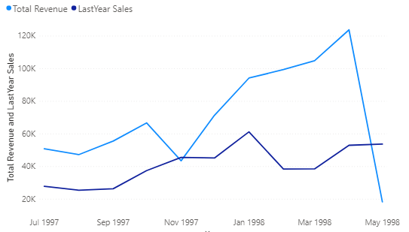
Same Period Last Year
On the Home tab, click the New measure button
Type the following DAX in the formula
box that opens
Click Enter and add LineChart
PutTotal Revenue and LastYear Sales to the Values section
Put the Date from the Calendar table to the Axis section.Show sales only 7/1/1997 - 6/1/1998 by applying a visual level filter to the chart
LastYear Sales =CALCULATE([Total Revenue], SAMEPERIODLASTYEAR('calendar'[Date]))
www.dsa.az Bütün hüquqlar qorunur.
DATA SCIENCE ACADEMY
3

Slide 4
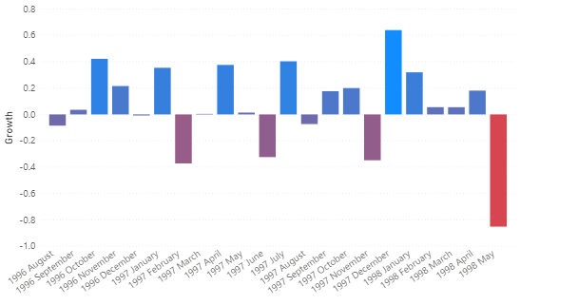
Previous Month
On the Home tab, click the New measure button
Type the following DAX in the formula box that opens
Create a new measure
Growth = DIVIDE([Total Revenue], [LastMonth Revenue], 0) *(-1)
Add a Clustered ColumnChart
Add Growth to the Values section, and Year, Month from the Calendar table to the Axis section
Eliminate cases with Growth -1 by applying a visual level filter to the graph.
LastMonth Revenue = CALCULATE([Total Revenue], PREVIOUSMONTH('calendar'[Date]))
www.dsa.az Bütün hüquqlar qorunur.
DATA SCIENCE ACADEMY
4

Slide 5
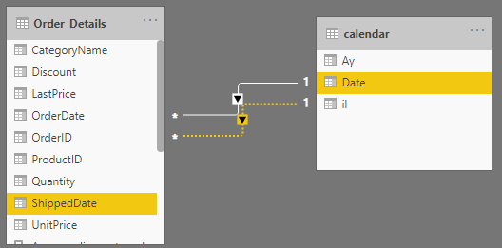
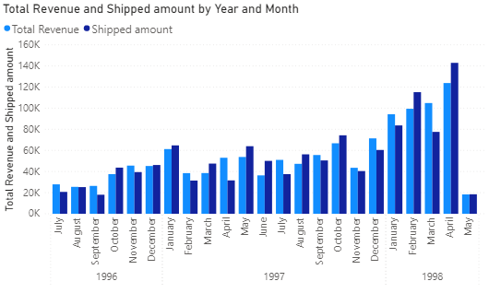
Use Relationship Formula
In the model view, create relationship between ShippedDate and Date from the calendar tableCreate a new measure.
Shipped amount = CALCULATE([Total Revenue], USERELATIONSHIP('calendar'[Date], Order_Details[ShippedDate]))
Add a Clustered ColumnChart.
In the Axis section, bring the Total revenue and Shipped amount measure from the calendar table to the Date values section.
www.dsa.az Bütün hüquqlar qorunur.
DATA SCIENCE ACADEMY
5

Slide 6
Filter and Avaragex formula
Create a new measure
Type the following DAX in the formula box that opens
Average discount small =
AVERAGEX(
FILTER(Order_Details,
Order_Details[Quantity]>2
&&Order_Details[Quantity]<15),
Order_Details[Discount]*Order_Details[UnitPrice]*Order_Details[Quantity])
Click Enter and center the measure you created and view the results.
The formula calculates the total discount amount for orders over 2 and under 15.
www.dsa.az Bütün hüquqlar qorunur.
DATA SCIENCE ACADEMY
6

Slide 7
Dates YTD
Create new measure
Type the following DAX in the formula box that opens
TotalYTD = CALCULATE([Total Revenue],
DATESYTD('calendar'[Date]))
Click Enter and center the measure you created and view the results.
The formula calculates the total sales from the beginning of the year to the selected date.
www.dsa.az Bütün hüquqlar qorunur.
DATA SCIENCE ACADEMY
7

Slide 8
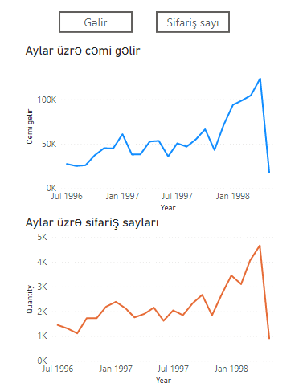
Bookmarks
Visualize total monthly income with LineChart
Show Order Numbers by Months on a Separate Line Chart (Quantity)
select Blank in the Buttons section of the Insert tab
Activate Button text on Visualizations section and type Gəlir
Create Sifariş button in the same way
Activate Bookmark and Selection windows from the View tab
www.dsa.az Bütün hüquqlar qorunur.
DATA SCIENCE ACADEMY
8

Slide 9
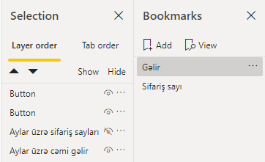
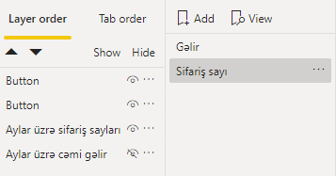
Bookmarks
Create a new Bookmark by clicking the Add button in the Bookmarks window that opens on the right
Double-click on the Bookmark and name it Gəlir
Create order number Bookmark by using Add
Select Gəlir Bookmark and from Selection section «Aylar üzrə sifariş sayı vizualını bağlayın»
Select Update by clicking on the three dots in front of the Gəlir Bookmark
Make a similar change to the order number Bookmark
Select Gəlir Button on Canvas and activate Action on Visualization section,select Type->Bookmark, Bookmark->Gəlir options
Follow the same options for the Order Number button
www.dsa.az Bütün hüquqlar qorunur.
DATA SCIENCE ACADEMY
9

Slide 10
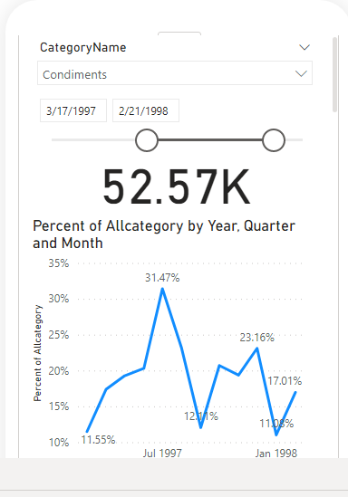
Mobile accounts
Click Mobile Layout button from View tab
Place the visuals that appear on the right side in the Mobile view
Click Mobile Layout button again, return to Desktop view mode
www.dsa.az Bütün hüquqlar qorunur.
DATA SCIENCE ACADEMY
10

Slide 11
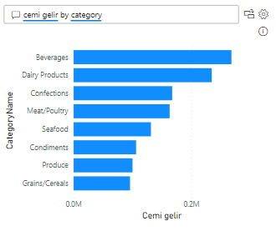
Q&A visual
Select Q&A visual from Visualization section
Type the following expression in the query section
cemi gelir by category
Make additional regulation by clicking the Settings button
In the Field synonyms section you can write synonyms in alternate versions of any column
Misunderstood expressions in the Tech Q&A section can be explained to the system
In the Suggested questions section, you can write advanced questions for the end user
In the Review questions section, you can explain to the system incorrect queries written by end users
www.dsa.az Bütün hüquqlar qorunur.
DATA SCIENCE ACADEMY
11

Slide 12
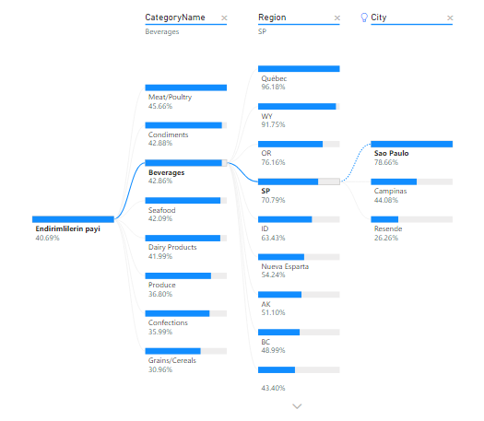
Decomposition Tree
Select Decomposition Tree visual from Visualizations section.
In the Fields section, enter the Endirimlilərin payı ölçümü to the Analyze section, bring CategoryName, City, Region variables to the Explain by.
Select the Category name by clicking the plus button in the visual.
Then click the plus button in the Beverages category and select High value
www.dsa.az Bütün hüquqlar qorunur.
DATA SCIENCE ACADEMY
12

Slide 13
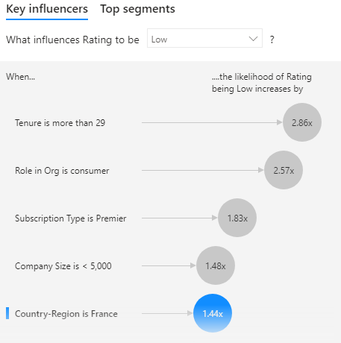
Key Influncers
Input Customer Feedback data
Select Key influencers visual from Visualization
In Fields section add Rating to analyze part
Bring Country-Region, Role in Org, Company size, Tenure, Subscription Type variables to Explain by
Select Low,in the What influences Rating to be section of the visual
www.dsa.az Bütün hüquqlar qorunur.
DATA SCIENCE ACADEMY
13

Slide 14
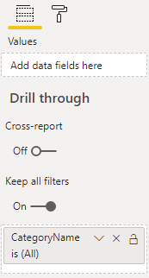
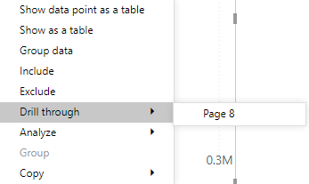
Drill through
Create a Bar chart of the total order amount by category on page 1
Show the total revenue for the months with LineChart on one of the other pages
Drag the CategroyName column to the Drill through section on the right side of the LineChart page
Return to page 1 right click on any Category, select Drill through
In conclusion, we can filter the visual from one page to another
www.dsa.az Bütün hüquqlar qorunur.
DATA SCIENCE ACADEMY
14

Slide 15
Reports sharing
Firstly, save your reports from File section by Save as or use Ctrl+S shortcut
Subsequently, enter to the sign in part on the Power BI desktop
After sign in click Publish button
Select one of the file which is active on Power BI service or select My Workspace file
Click OK
www.dsa.az Bütün hüquqlar qorunur.
DATA SCIENCE ACADEMY
15

Slide 16
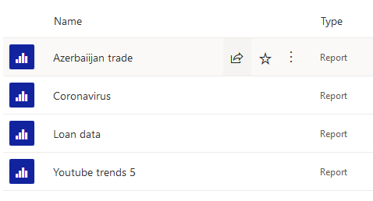
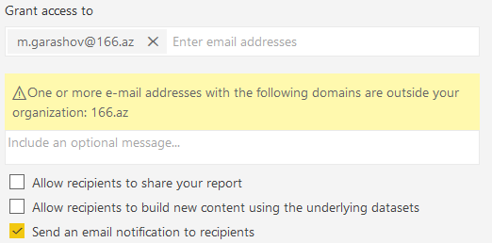
Sharing Reports to Users
https://powerbi.microsoft.com/en-us/ Enter your account with sign in by this site
Then enter sign in part in Power BI
After that, find your reports from My Workspace or Workspaces files
Select Share from the options that pop up when you get to the top of the report
In the Grant access to field, enter the username of the employee with the Power BI account and disable the displayed options
www.dsa.az Bütün hüquqlar qorunur.
DATA SCIENCE ACADEMY
16

Slide 17
Thank you!

